Slide 1
Exploring Toronto for new business
Data Science Capstone

Slide 2
New pizza business in toronto
A pizza restaurant owner has two restaurants located in Manhattan, in the Carnegie Hill and Hamilton Heights Neighborhoods, and he wants to open a new restaurant in Toronto. He is making a research about the neighborhoods were his restaurants are located, in order to have a profile of the neighborhood he is looking for in Toronto. What the owner needs is to find similar neighborhoods in Toronto where he can open his new restaurant.

Slide 3
Data acquisition and cleaning
New York neighborhood information can be found on the following link on the internet, in JSON format: https://geo.nyu.edu/catalog/nyu_2451_34572
Toronto Neighborhoods can be found on Wikipedia: https://en.wikipedia.org/wiki/List_of_postal_codes_of_Canada:_M
The places we are looking for Neighborhood profile will be obtained using Foursquare API, and to perform this we will need the coordinates of each Neighborhood.

Slide 4
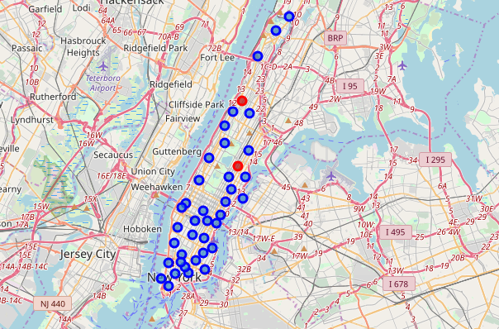
Manhattan neighborhoods
Pizza Restaurant locations

Slide 5
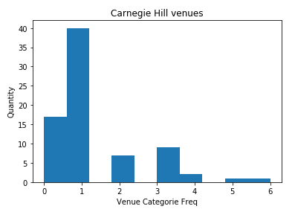
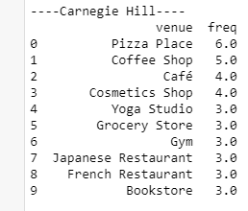
Carnegie Hill
Carnegie hills venues: From foursquare api top100 venues are extracted and then the distribution is showed in a histogram showing about the most common venues, and also top10 venues are extracted in order to tell more about the neighborhood based on venues

Slide 6
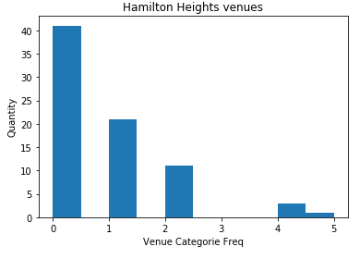
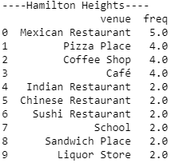
Hamilton heights
Hamilton height venues: From foursquare api top100 venues are extracted and then the distribution is showed in a histogram showing about the most common venues, and also top10 venues are extracted in order to tell more about the neighborhood based on venues

Slide 7
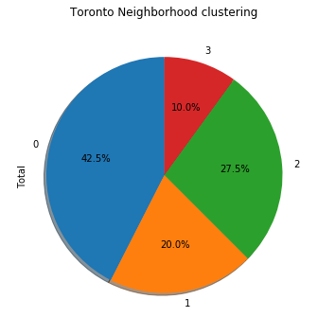
Toronto neighborhoods
Now that we know more about the manhattan neighborhoods, we add them to the list of neighborhoods of Toronto in order to be clustered using k-means cluster algorithm with other similar neighborhoods.
K-means algorithm is an unsupervised machine learning algorithm that will cluster neighborhoods that has similar venues. After clustering the results are as following (interested neighborhoods has cluster label 3)

Slide 8
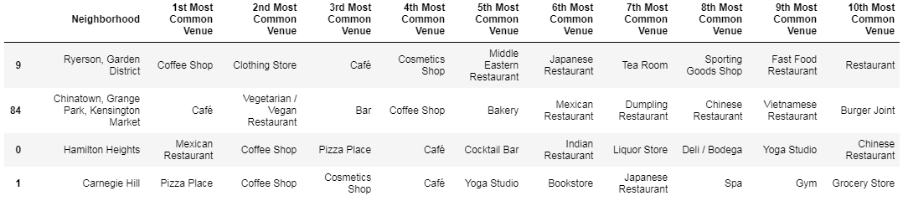
results
K-means algorithm recommends two neighborhoods to open the new restaurant in toronto.

Slide 9
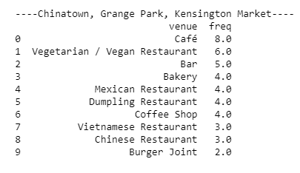
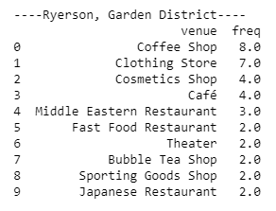
Conclusions
K-means recommended neighborhoods are based on venues in neighborhoods.
What we were trying on this problem was to understand the data of each neighborhood based on venues in neighborhood. This could be one valuable resource for making recommendations for the owner, but is necessary to remember that not only the places around matter since the culture of each country can impact in the development of new business

